Slide 1
Version Control Repository usage for code and artifacts
Notes:
The automation doesn’t really have artifacts since we are doing administration rather than application development.
What artifacts we do have are logs which are stored in the GoCD pipeline and on the Go server.
Wayne – Self Service Tool (this may be a different)

Slide 2
History
Notes:
Mercurial (Atlassian just removed support for Mercurial)
SVN (Subversion)
BitKeeper – this was not open source and Linus didn’t like SVN so Git was born

Slide 3
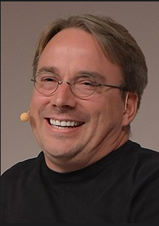
Linus Torvalds
The inventor of Linux and Git:
https://en.wikipedia.org/wiki/Linus_Torvalds
Notes:
Image from Wikipedia:
https://en.wikipedia.org/wiki/File:LinuxCon_Europe_Linus_Torvalds_03_(cropped).jpg

Slide 4
Why learn it
Notes:
Do you have files labeled version 1, version 2
It is the de facto standard
It is the company standard (We also used Mercurial until Atlassian discontinued support for it.)
It is not just for programmers (this whole presentation is in a private Training repository)

Slide 5
Why we use it
Notes:
It can save your rear end. (Ability to recover previous versions)
It allows multiple people to work on the same document at the same time.
Better cross team functionality
Traceability
Accountability (Git blame) – it tracks who made changes to a document
MANAGERIAL REASON: If your laptop is lost, stolen or destroyed your work is recoverable.

Slide 6

Notes:
You just deleted something you didn’t mean to.

Slide 7

Notes:
You pull the last committed version from git. Commit regularly!

Slide 8
Local Repositories
Notes:
These are for the items that you would save to your local hard drive but you want version control.

Slide 9
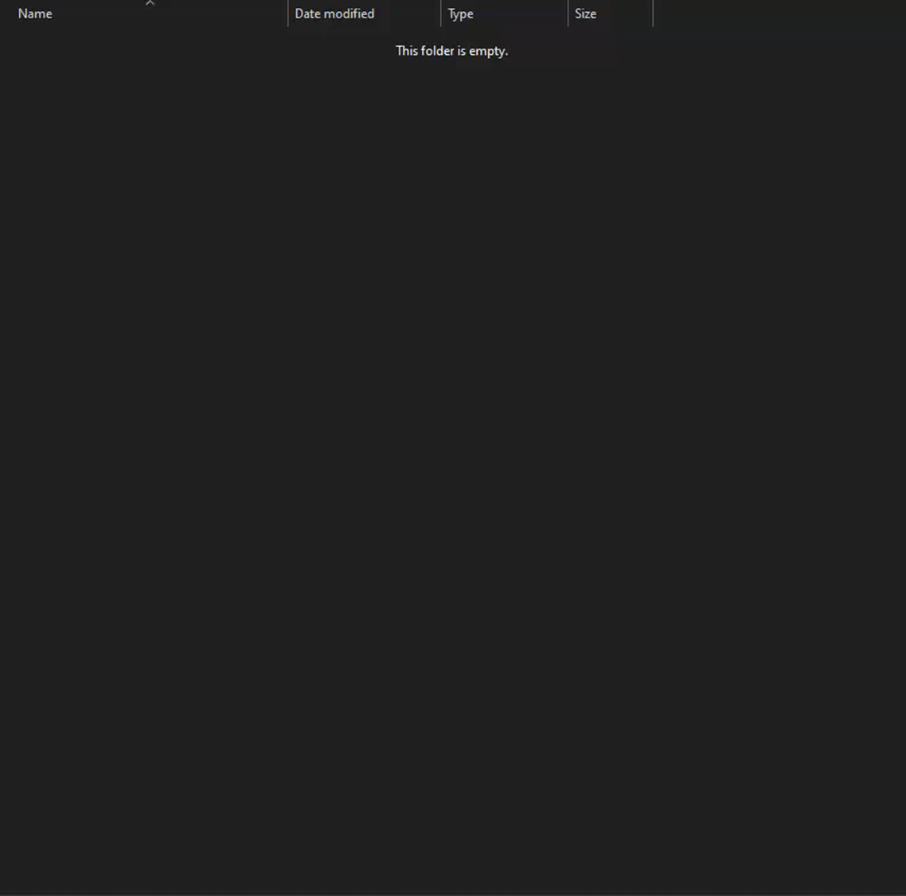
Initialize a local repository

Slide 10
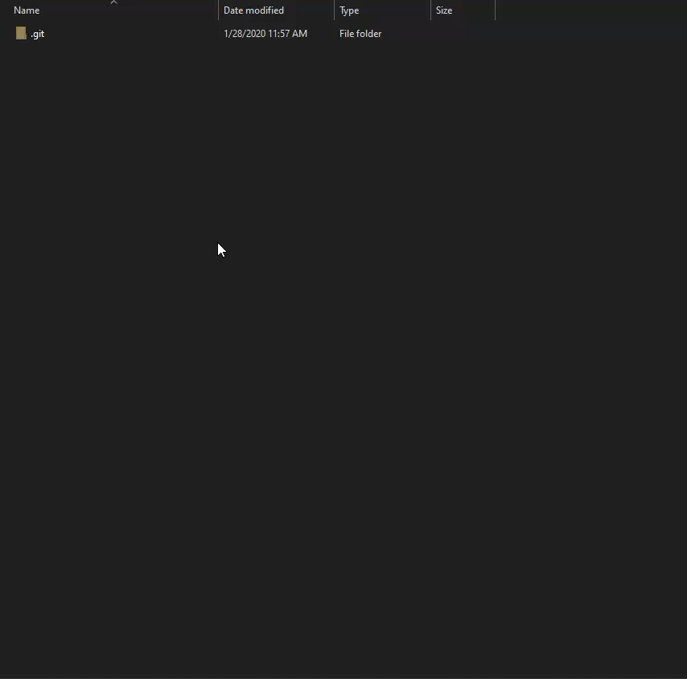

Adding a file

Slide 11
Remote Repositories
Notes:
Cloning

Slide 12
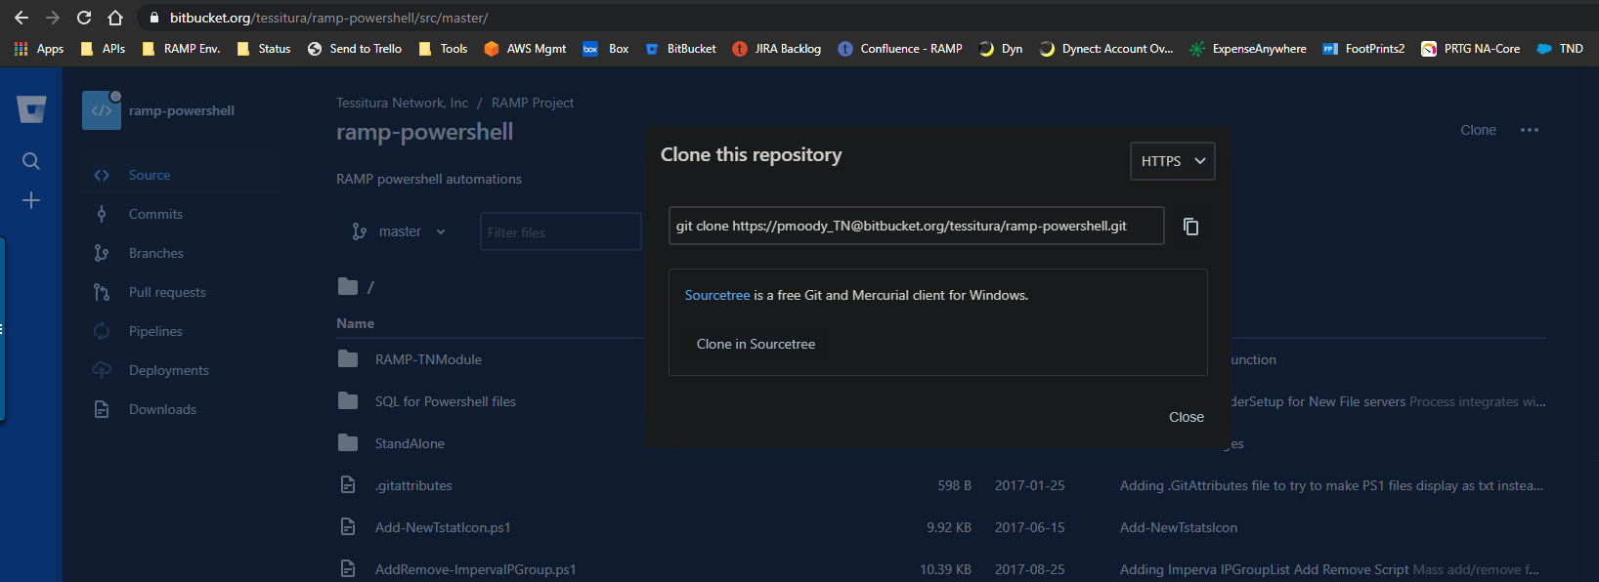

Clone a repo
Notes:
First get the URL or UNC of the repo that you want to clone

Slide 13
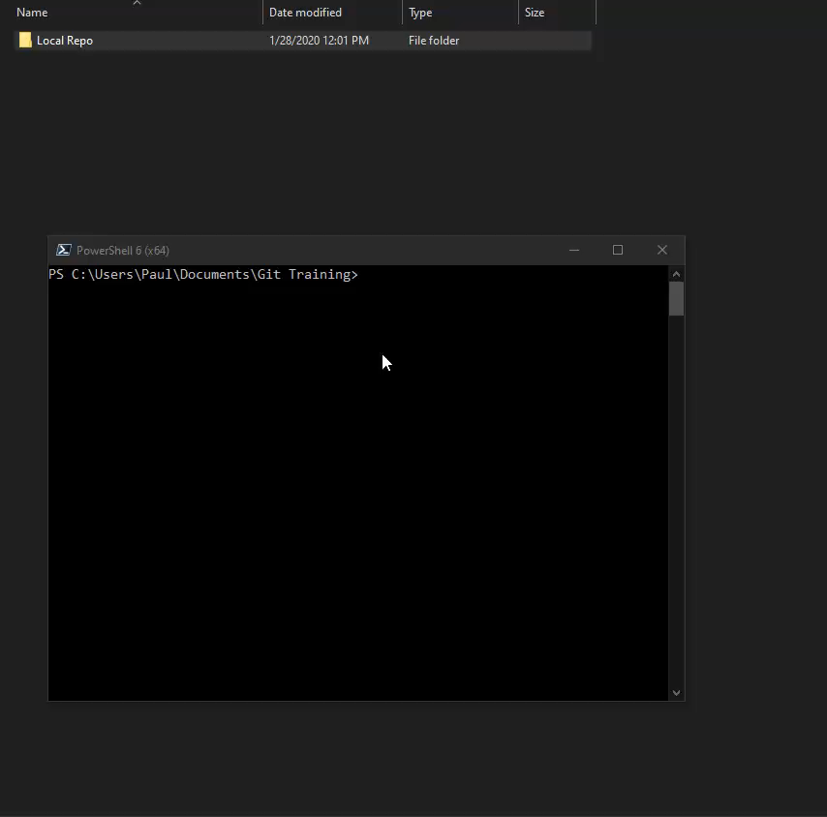
Clone a repo
Notes:
Cloning a repository will make a folder and copy the contents and history into this new location.
This can be deleted and cloned again – presuming you have committed and pushed all of your changes before deleting the folder.

Slide 14
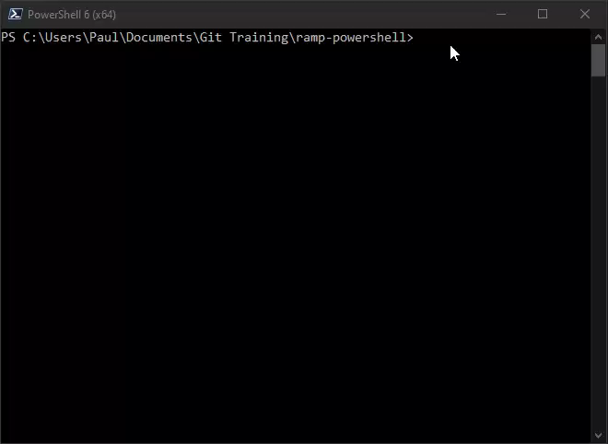
Pull - Check
for updates
Notes:
Do this to start your day and before you push files up to the repo.

Slide 15
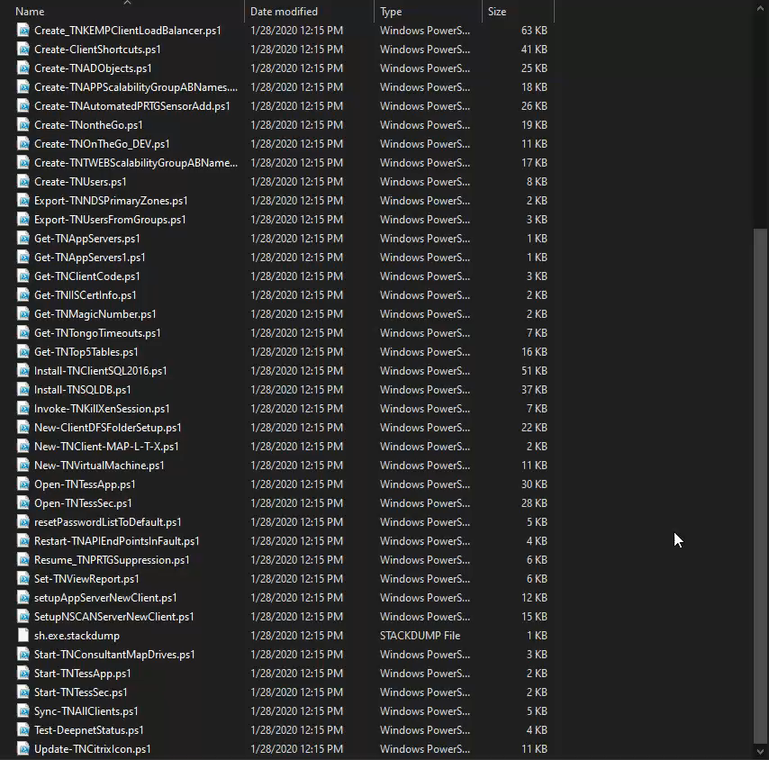

Adding a file
And pushing

Slide 16
How can I learn this?

Slide 17

Knowing Linux is helpful
Single hyphen (-) is used for a letter
git commit –m ‘Message goes here’
[for adding a commit message]
Double hyphen (--) is used for a word
git log --help
[for the log command help]
Git is case sensitive
Notes:
git log examples
git log %H
Commit hash
git log %h
Abbreviated commit hash
-s
--no-patch
Suppress diff output
-S<string>
Look for differences that change the number of occurrences of the specified string (i.e. addition/deletion) in a file. Intended for the scripter’s use.

Slide 18

Built in help
Man(ual) pages – Linux help pages
man git – lists all of the top level commands
Help pages
git log --help – this will give you the help page for the log command
https://git-scm.com/docs
Notes:
Man pages are Linux only
Help in Windows will open the webpage – which are all of the man pages

Slide 19

The internet
Git’s website:
https://git-scm.com/docs/git-help
Google:
Something specific
There are a lot of articles on Git.
YouTube
Git basics
Notes:
Googling specific tasks can be really helpful.
How do I change a commit message in Git?

Slide 20

Books
Pro Git is free from the Git website
https://git-scm.com/book/en/v2
Manning Publishing:
Git in a Month of Lunches
O’reilly Media: https://ssearch.oreilly.com/?q=Git
Notes:
I learned from Git in a Month of Lunches and playing with the tools.
ARTICLES are a good source of information too.

Slide 21

Online Courses
Linux Academy
Udemy
PluralSight
W3Schools
FreeCodeCamp.org
CBTNuggets

Slide 22
Recommendations

Slide 23
If Code or Documentation is for production use it should be in a system that has version control.
Notes:
Git, Confluence, Team Support are all version controlled systems

Slide 24
Production Repos
General Scripts
\\tnhs\global\admin\scripts
GoCD Pipeline Scripts
\\tnhs\global\admin\go\scripts
Client Configuration files
\\tnhs\global\Admin\ramp-gocd-client-configs
Notes:
If a file is in one of these folders it is ready for production and should be committed to the repo and pushed to BitBucket.

Slide 25
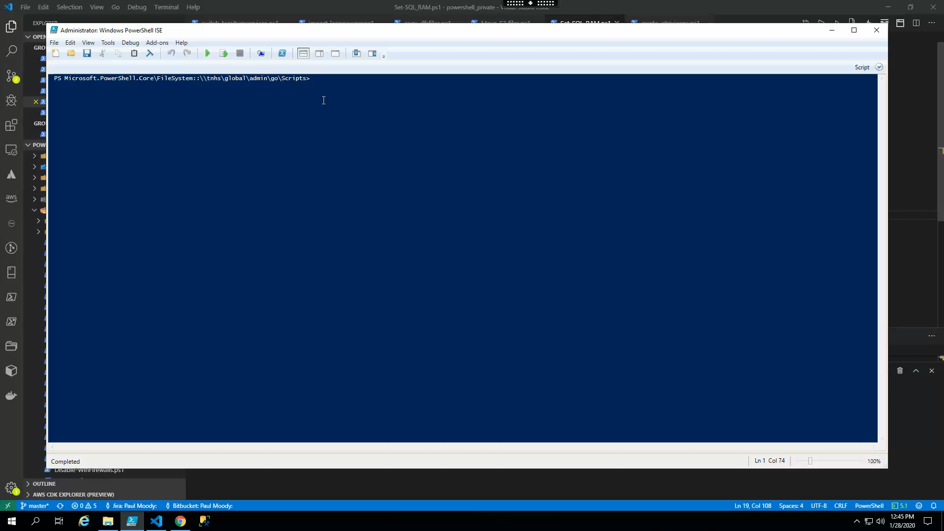
Making sure your files are in the repository git status
Notes:
git pull
git status

Slide 26
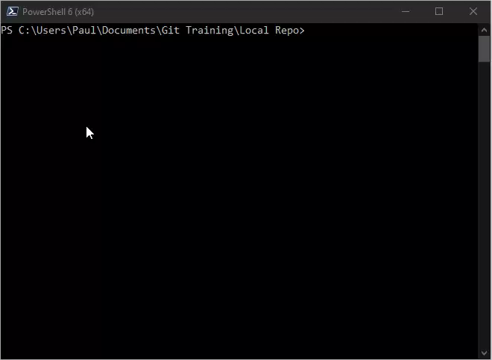
Making sure your files are in the repository git log
Notes:
git pull
git status
git log

Slide 27

Commit Messages
The first commit should explain why the script was added to the repository and what the script does.
If you are updating code the commit should explain what changed.
Initial commit:
This will add XXXYYY folder
The folder is needed because…
RPSY-000000
Update commit:
Now the folder is named AAABBB
RPSY-000001
Notes:
You don’t always need more than one line.
Just a JIRA card can be sufficient for the additional information if there is enough detail in the card

Slide 28
Commits
Use JIRA card numbers when appropriate
The first line is special
You can write a small book after the first line carriage return

Slide 29
GUIs
Gitk (built in GUI for visualizing the branches)
Git GUI comes with windows git
SourceTree (BitBuckets GUI)
VSCode
GitKraken
Fork
Notes:
VSCode is my (Paul’s) personal favorite.
If you are not comfortable with CLI GUIs are a great way to learn the commands that are being done and then you can Google those commands to learn how to use the CLI.
I do this a lot with AWS Console and CLI.

Slide 30
CLI vs GUI
CLI is king. Git was created by Linus. All of the functionality is available through the CLI. All GUIs are just doing CLI commands underneath.
GUIs are great for visualization.
GUIs can be better for adding and updating comments; among other tasks.

Slide 31
Git Aliases
Making CLI life a little easier:
git lol
log --graph --decorate --pretty=oneline --abbrev-commit --all‘
git config --global --add alias.lol "log --graph --decorate --pretty=oneline --abbrev-commit --all"
gcm
git commit –m
git config --global --add alias.gcm “git commit -m"
Notes:
Google useful git aliases

Slide 32
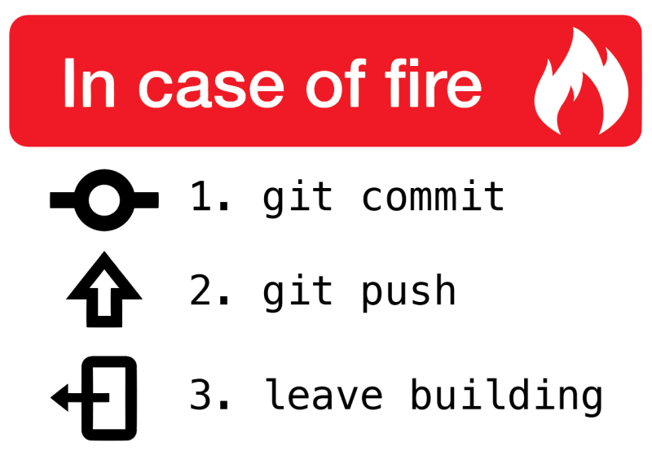
Remote Repositories
Notes:
Personally I think there should be a 0. git add * …

Slide 33
Notes:
Resources:
Chris V & Paul
Chantry, Wayne, Brian G.

